Slide 1
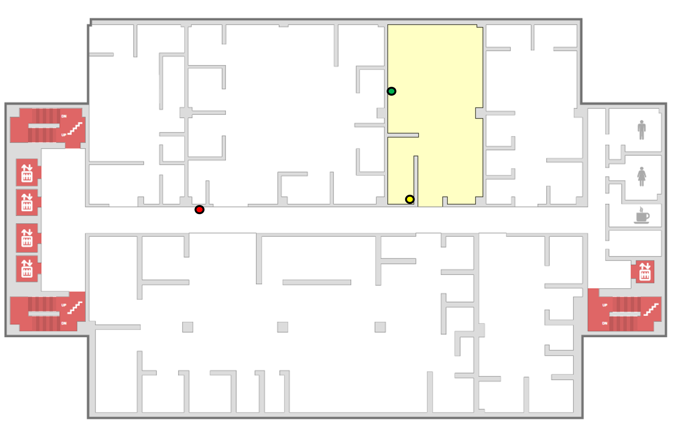
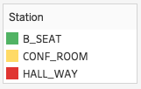
Patient Care Demo Set up
Three Care Active stations: B-seat, Conf-room, Hall-way
Two Care Active Watches devices: PWD, CG
Annotations
PWD
Care Giver

Slide 2
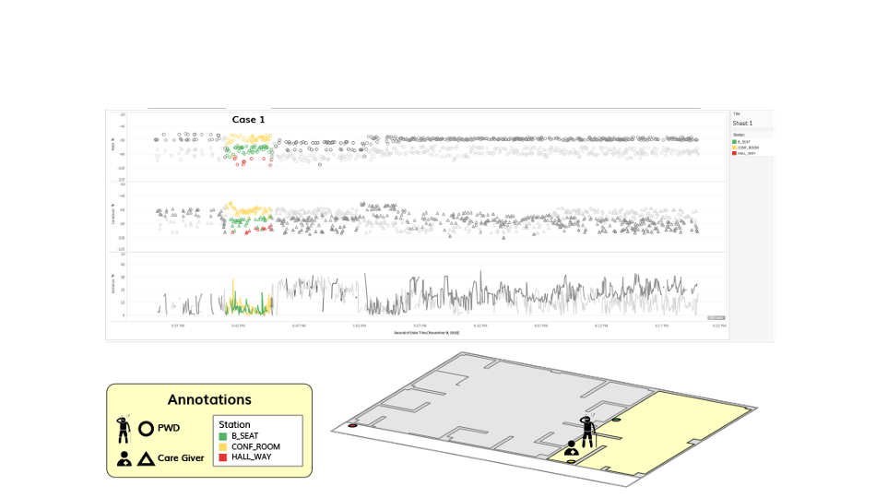
Patient Care Activity Monitor (Raw Data)

Slide 3
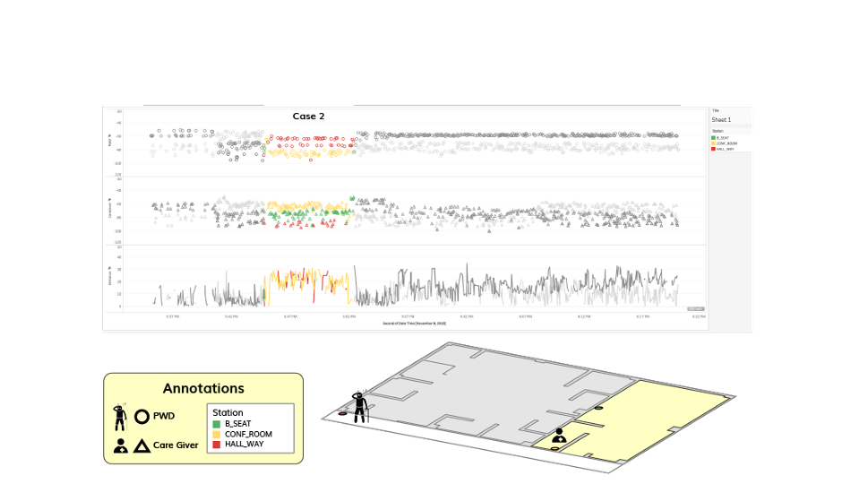
Patient Care Activity Monitor (Raw Data)

Slide 4
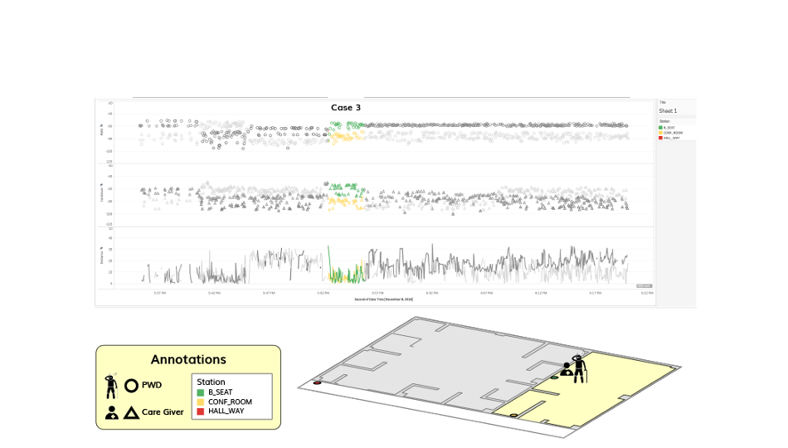
Patient Care Activity Monitor (Raw Data)

Slide 5
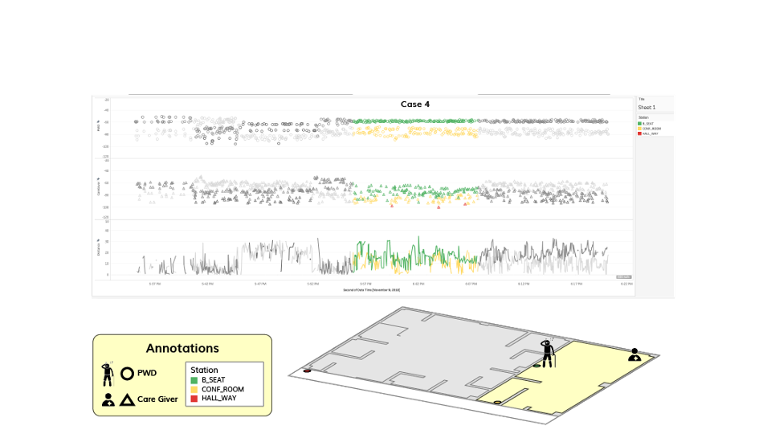
Patient Care Activity Monitor (Raw Data)

Slide 6
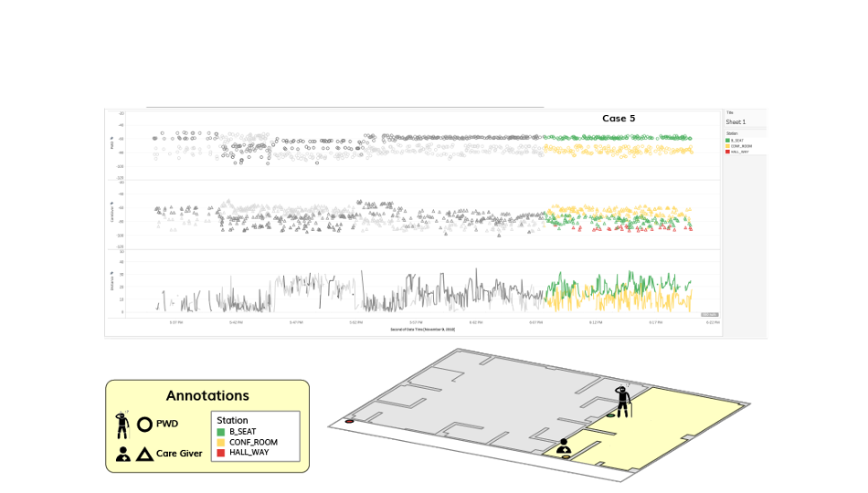
Patient Care Activity Monitor (Raw Data)

Slide 7
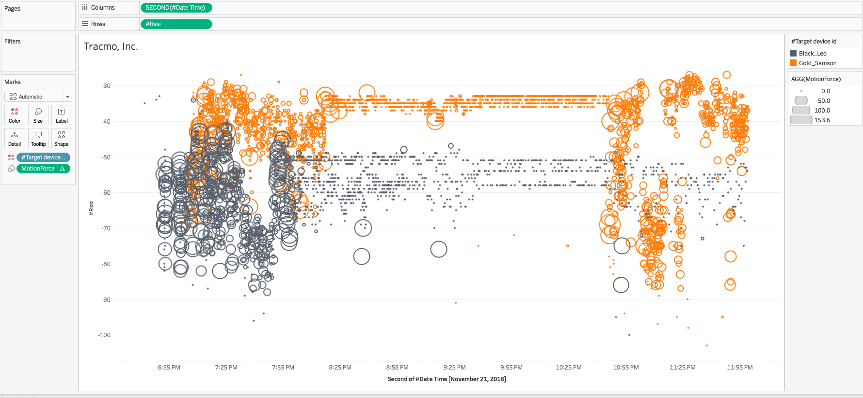
Motion Activities
More Activities

